Slide 1
BANOGUE NATIONAL SCHOOL
OPEN EVENING
February 2023

Slide 2
SCHOOL PROFILE AND FACILITIES

Slide 3
SCHOOL PROFILE AND FACILITIES
Small rural school
Four mainstream classes
One ASD class opened September 2021
2nd ASD class sanctioned to open Sept.2023
School opened in 1967
Addition of an extension to the school in 2013
School facilities include:

Slide 4
A LARGE OUTDOOR PLAY AREA

Slide 5
AN EXTENSIVE GREEN PLAYING PITCH

Slide 6
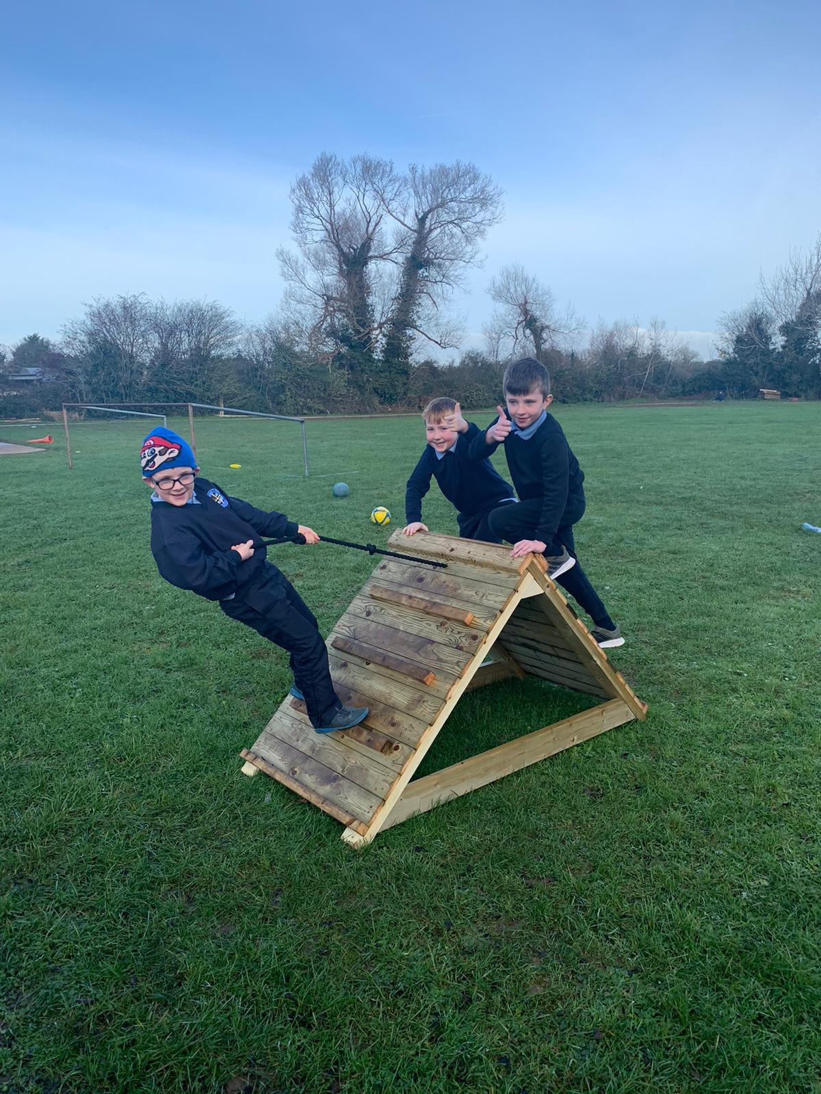
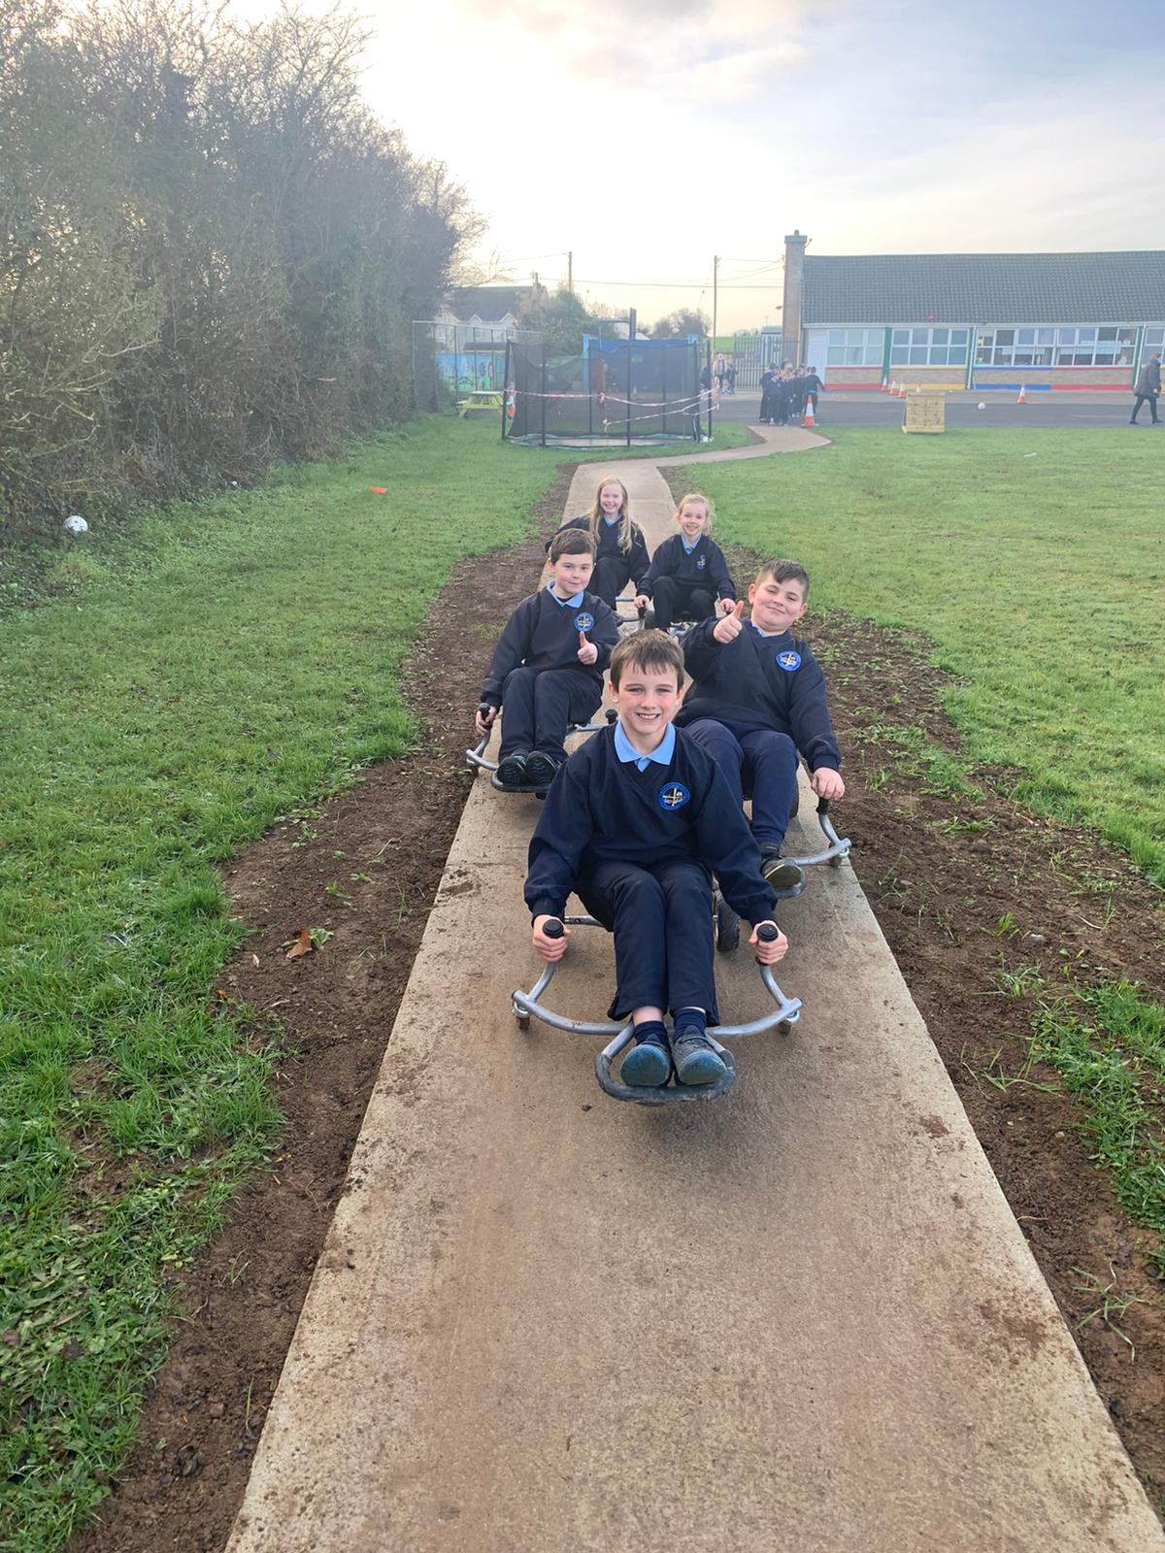
OUTDOOR LEARNING AREA
OUTDOOR ACTIVITY AREA

Slide 7
A LARGE COMMUNITY HALL

Slide 8
A BRIGHT NEW EXTENSION

Slide 9
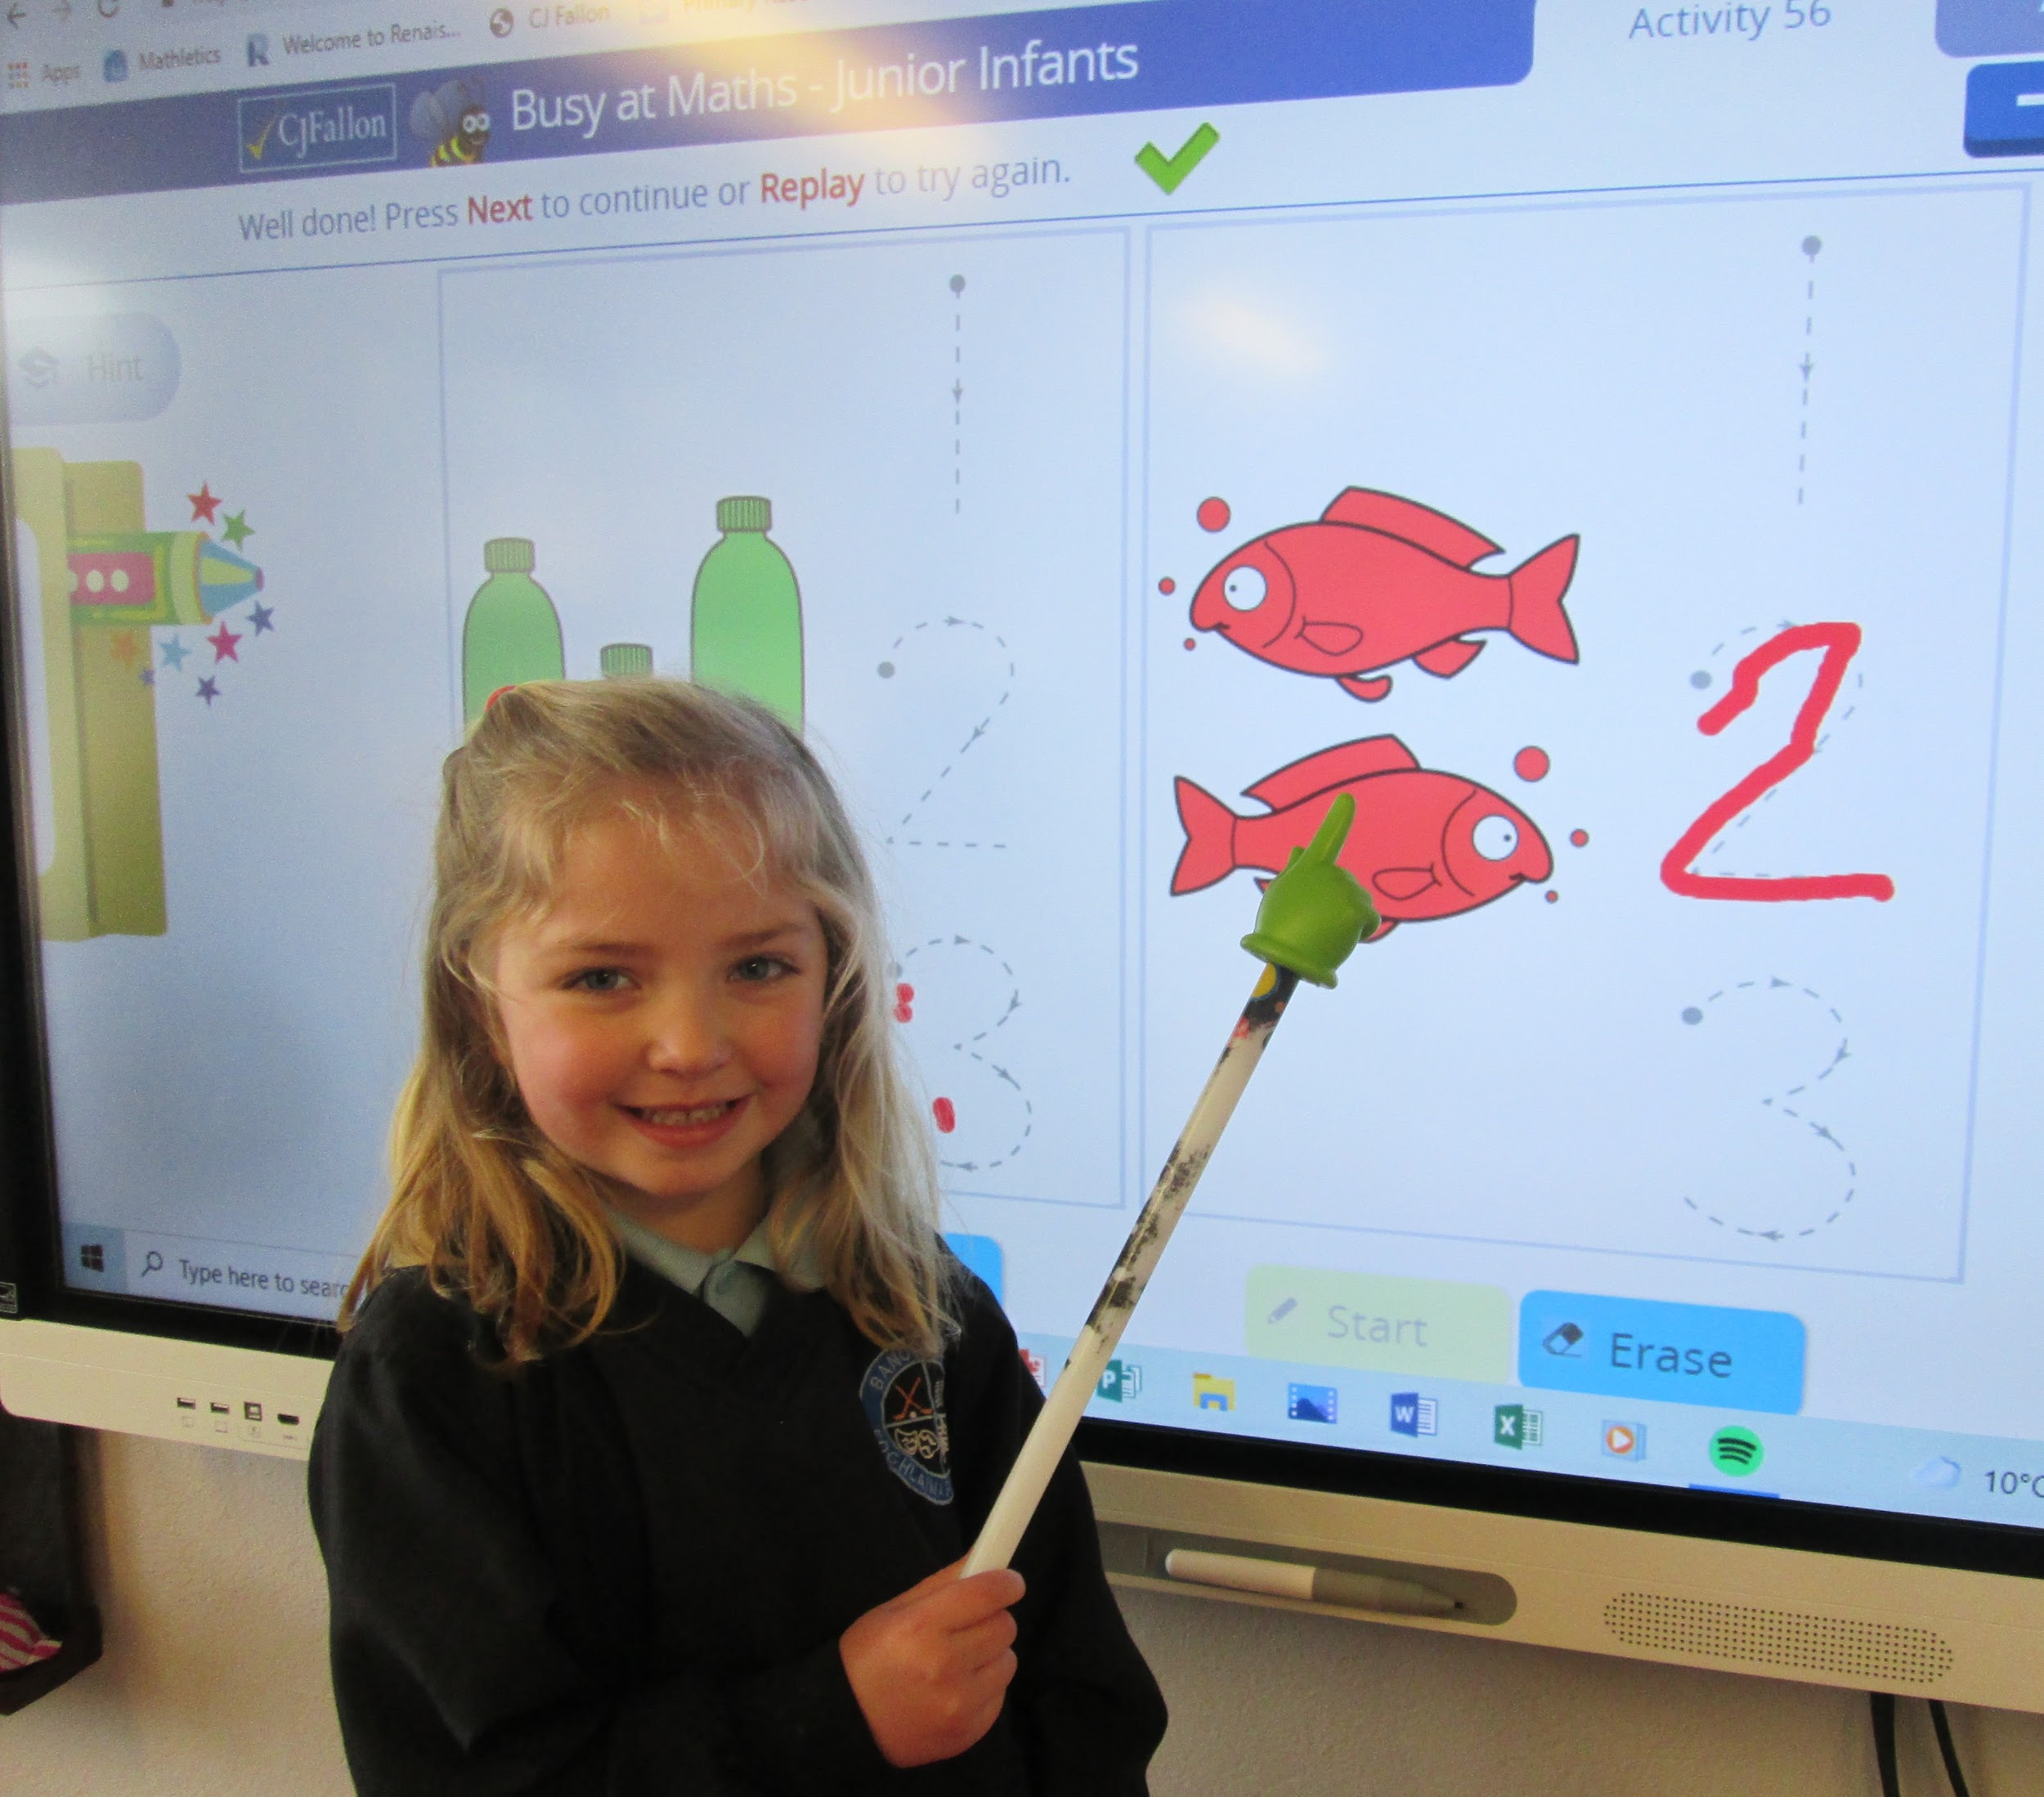
INTERACTIVE WHITEBOARDS IN EACH CLASSROOM

Slide 10
CLASSROOM LIBRARIES

Slide 11
SPECIAL EDUCATIONAL NEEDS ROOM

Slide 12
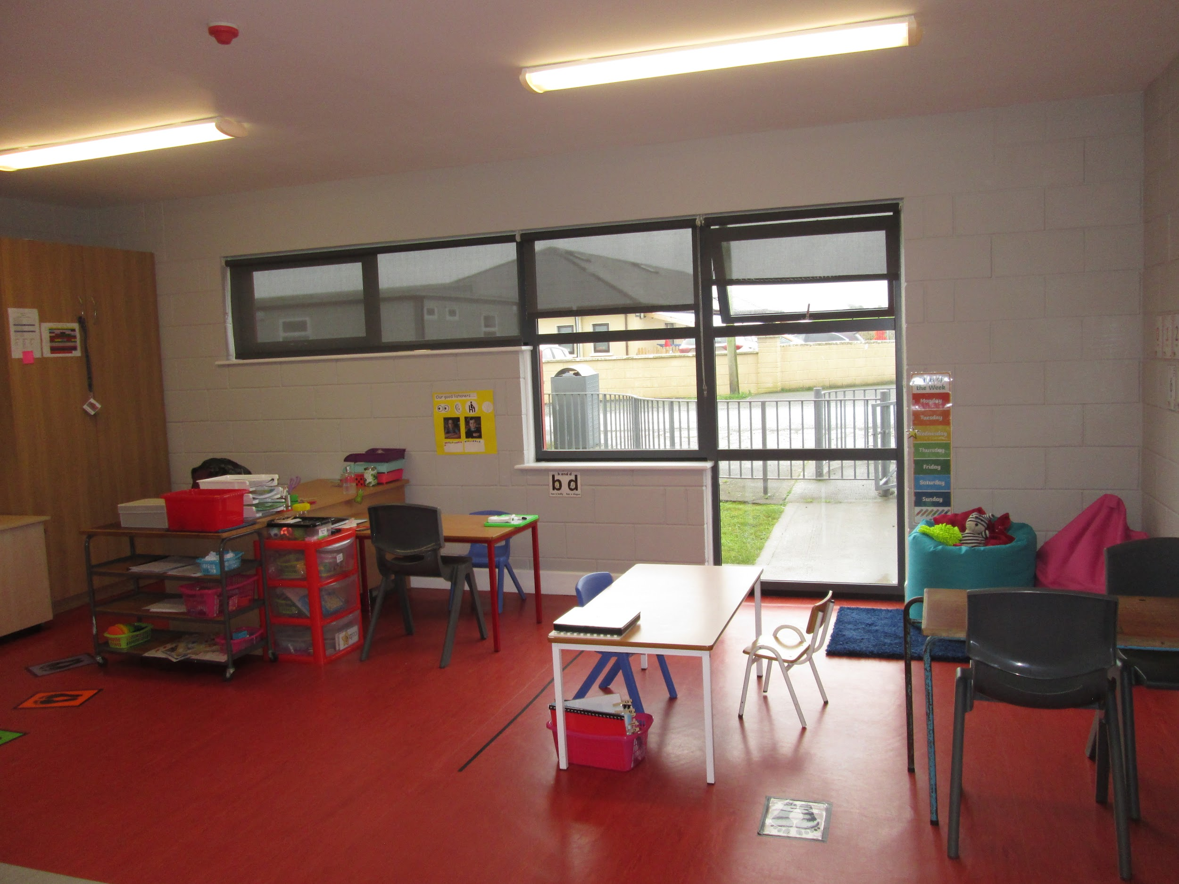
ASD CLASSROOM
Our school opened its first ASD class in August 2021 and we are delighted that a 2nd class has been sanctioned to open in September 2023.
Our ASD class operates using the TEACCH Autism Programme.
We enable children to access the curriculum using tools and resources appropriate to their needs with a lower pupil to staff ratio.
Pupils from the ASD class can also benefit from integration with their mainstream peers.

Slide 13
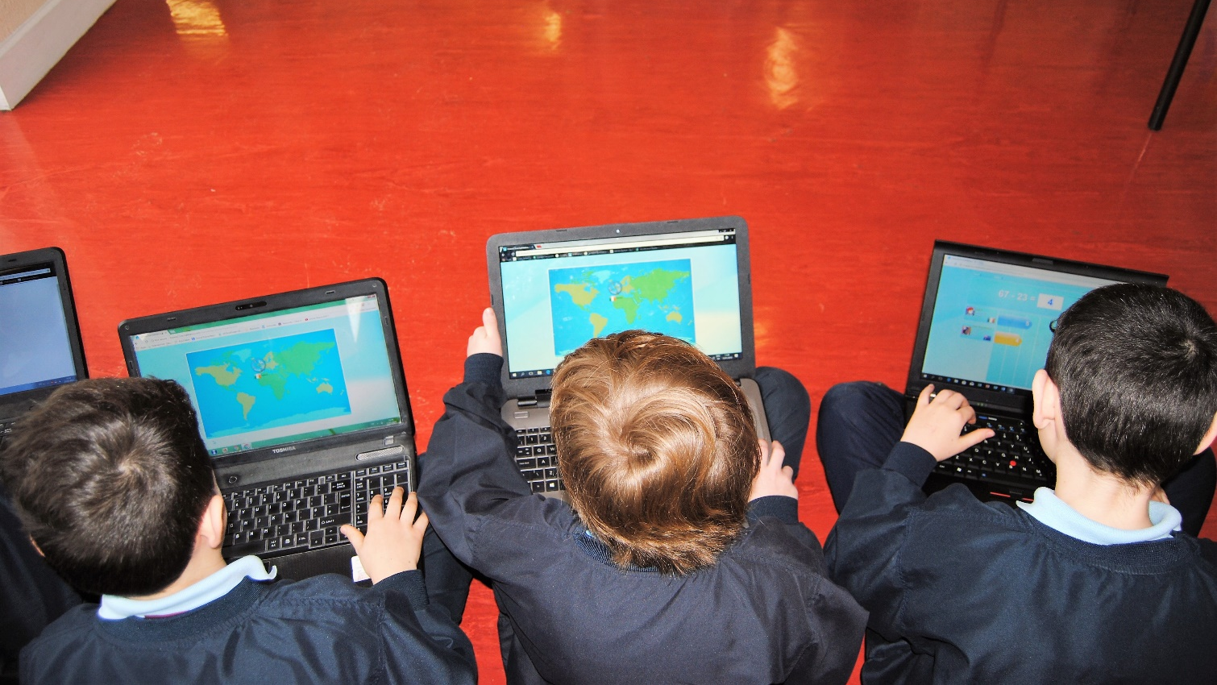
STATE OF THE ART TECHNOLOGY

Slide 14
ABOUT OUR SCHOOL
7 teachers on staff. 4 mainstream teachers, 2 Learning support teachers and 1 special class teacher
We are a growing school and we appointed our 4th mainstream teacher in September 2022.
2 classes are taught in each room. Junior and Senior Infants, 1st and 2nd , 3rd and 4th. 5th and 6th.
We also have one ASD class for children who have been diagnosed with autism and we have a second ASD classroom sanctioned to open in September
Four full time Special Needs Assistants are employed at the school.

Slide 15
ADVANTAGES OF SMALL RURAL SCHOOL
Small school maximises the time allocated to each child – 11 adults : 85 pupils*
Staff focused on children achieving individual potential
Minimum disciplinary problems
Mixed class levels - higher ability children challenged / consolidation of concepts.
Early intervention effective due to small infant class size.
*21% of school’s in Ireland are 3 or 4 teacher schools

Slide 16
CURRICULUM
Language: Gaeilge and English
Mathematics
Social, Environmental and Scientific Education (SESE): History, Geography and Science
Arts education: Visual Arts, Music and Drama
Physical Education
Social, Personal and Health Education (SPHE)
Religious or ethical education is the responsibility of the different school patron bodies.

Slide 17
CURRICULUM
The Curriculum is presented in two year cycles:
Junior / Senior Infants
First / Second Class
Third / Fourth Class
Fifth / Sixth Class
This Structure lends itself to a mixed class situation such as ours which is the norm in a rural school

Slide 18
HOW THE CURRICULUM IS TAUGHT…

Slide 19
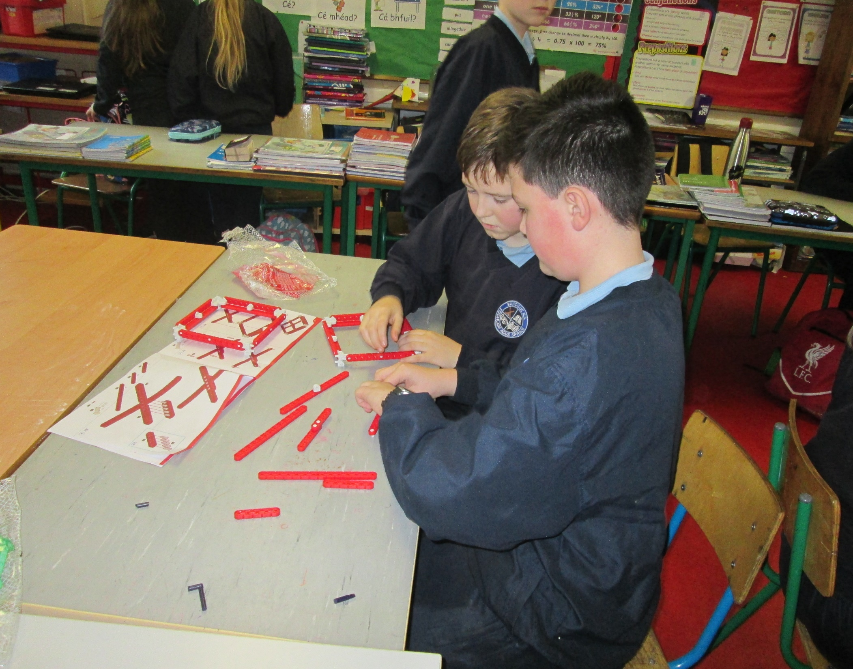
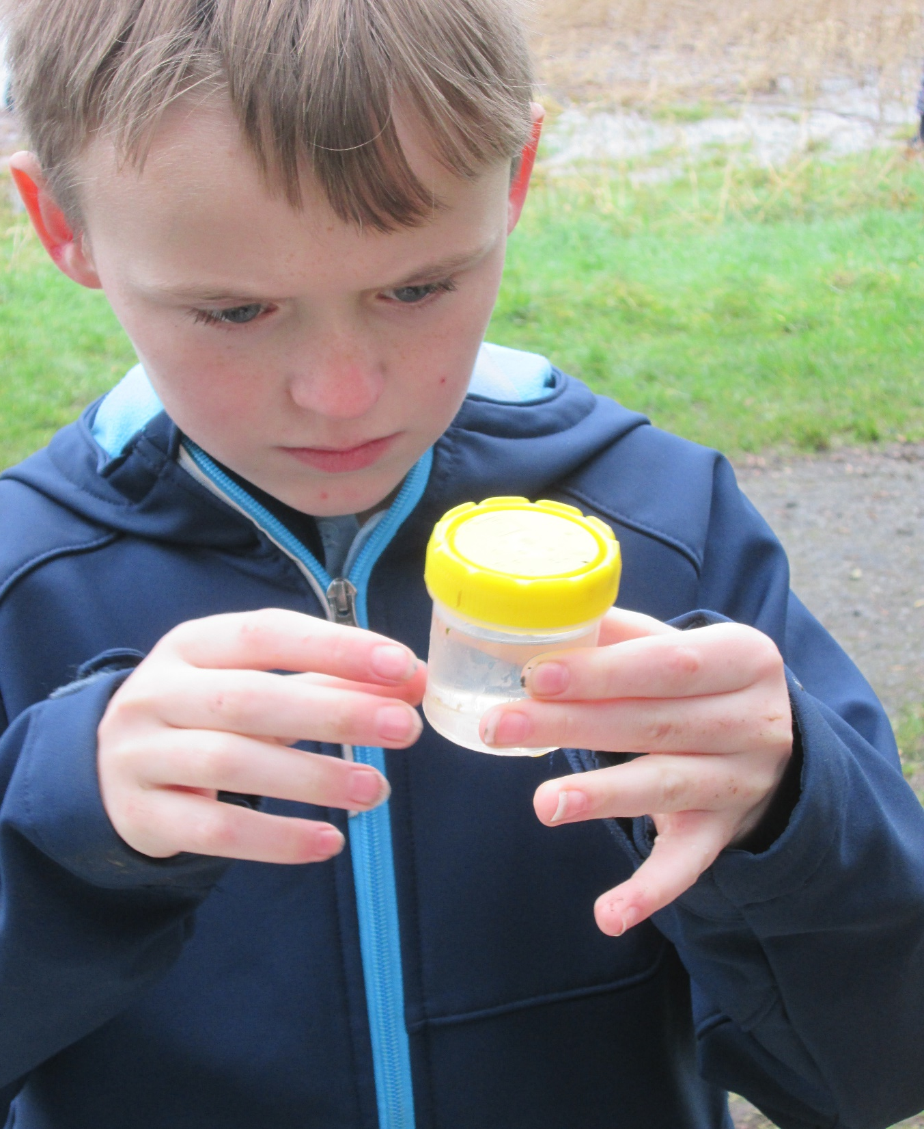
CHILD AS AN ACTIVE LEARNER
All subjects of the curriculum encourage active learning experiences that will make learning interesting, enjoyable and fulfilling.

Slide 20
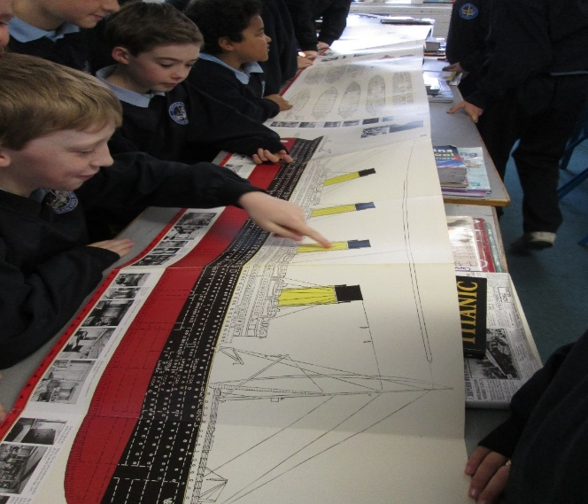
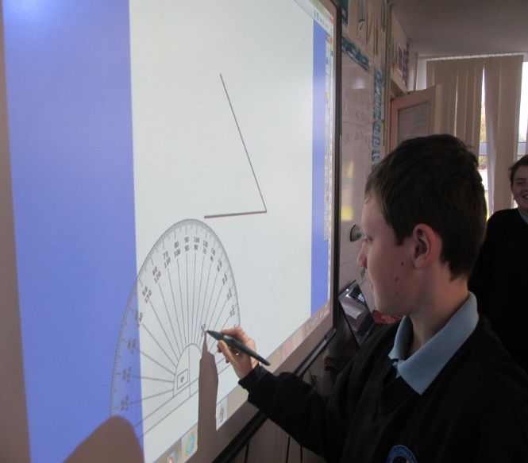
CHILDREN USING CONCRETE MATERIALS
Children learn best when they are actively involved in learning, that is taking part in interesting and stimulating activities

Slide 21
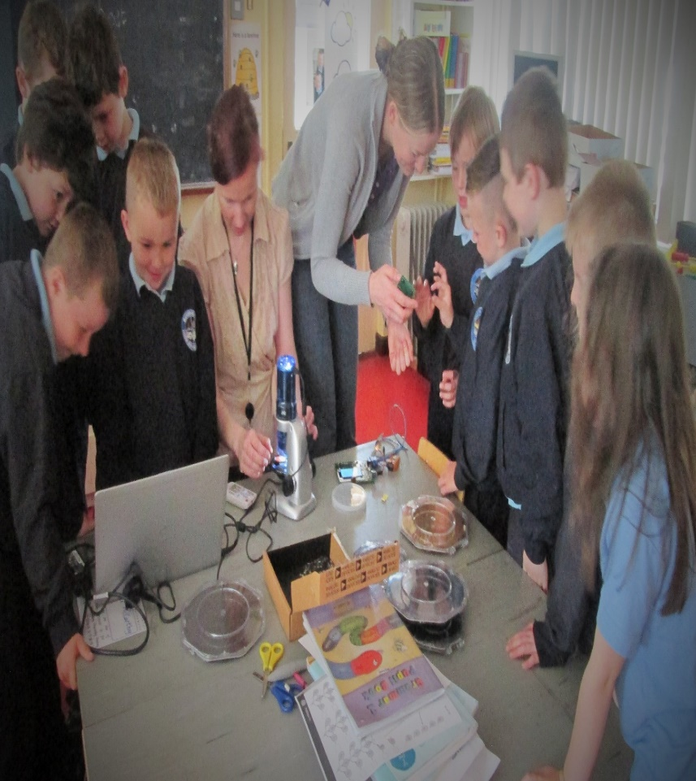
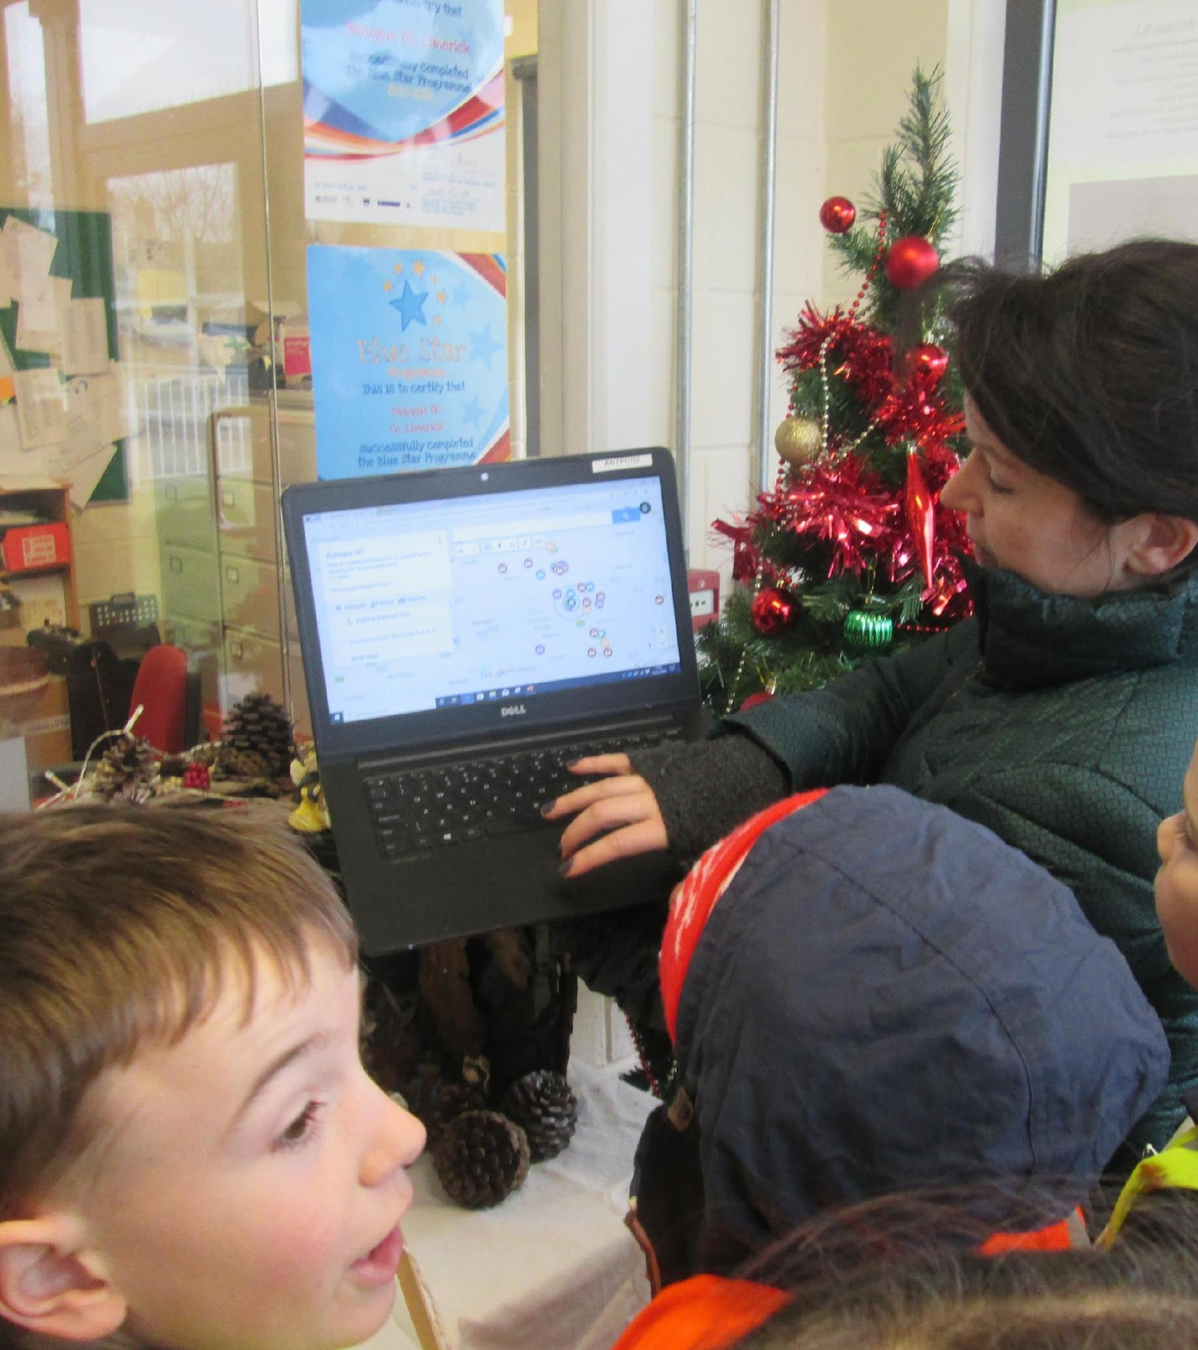
EDUCATIONAL VISITORS TO SCHOOL
Learning arouses their curiosity and harnesses their sense of wonder

Slide 22
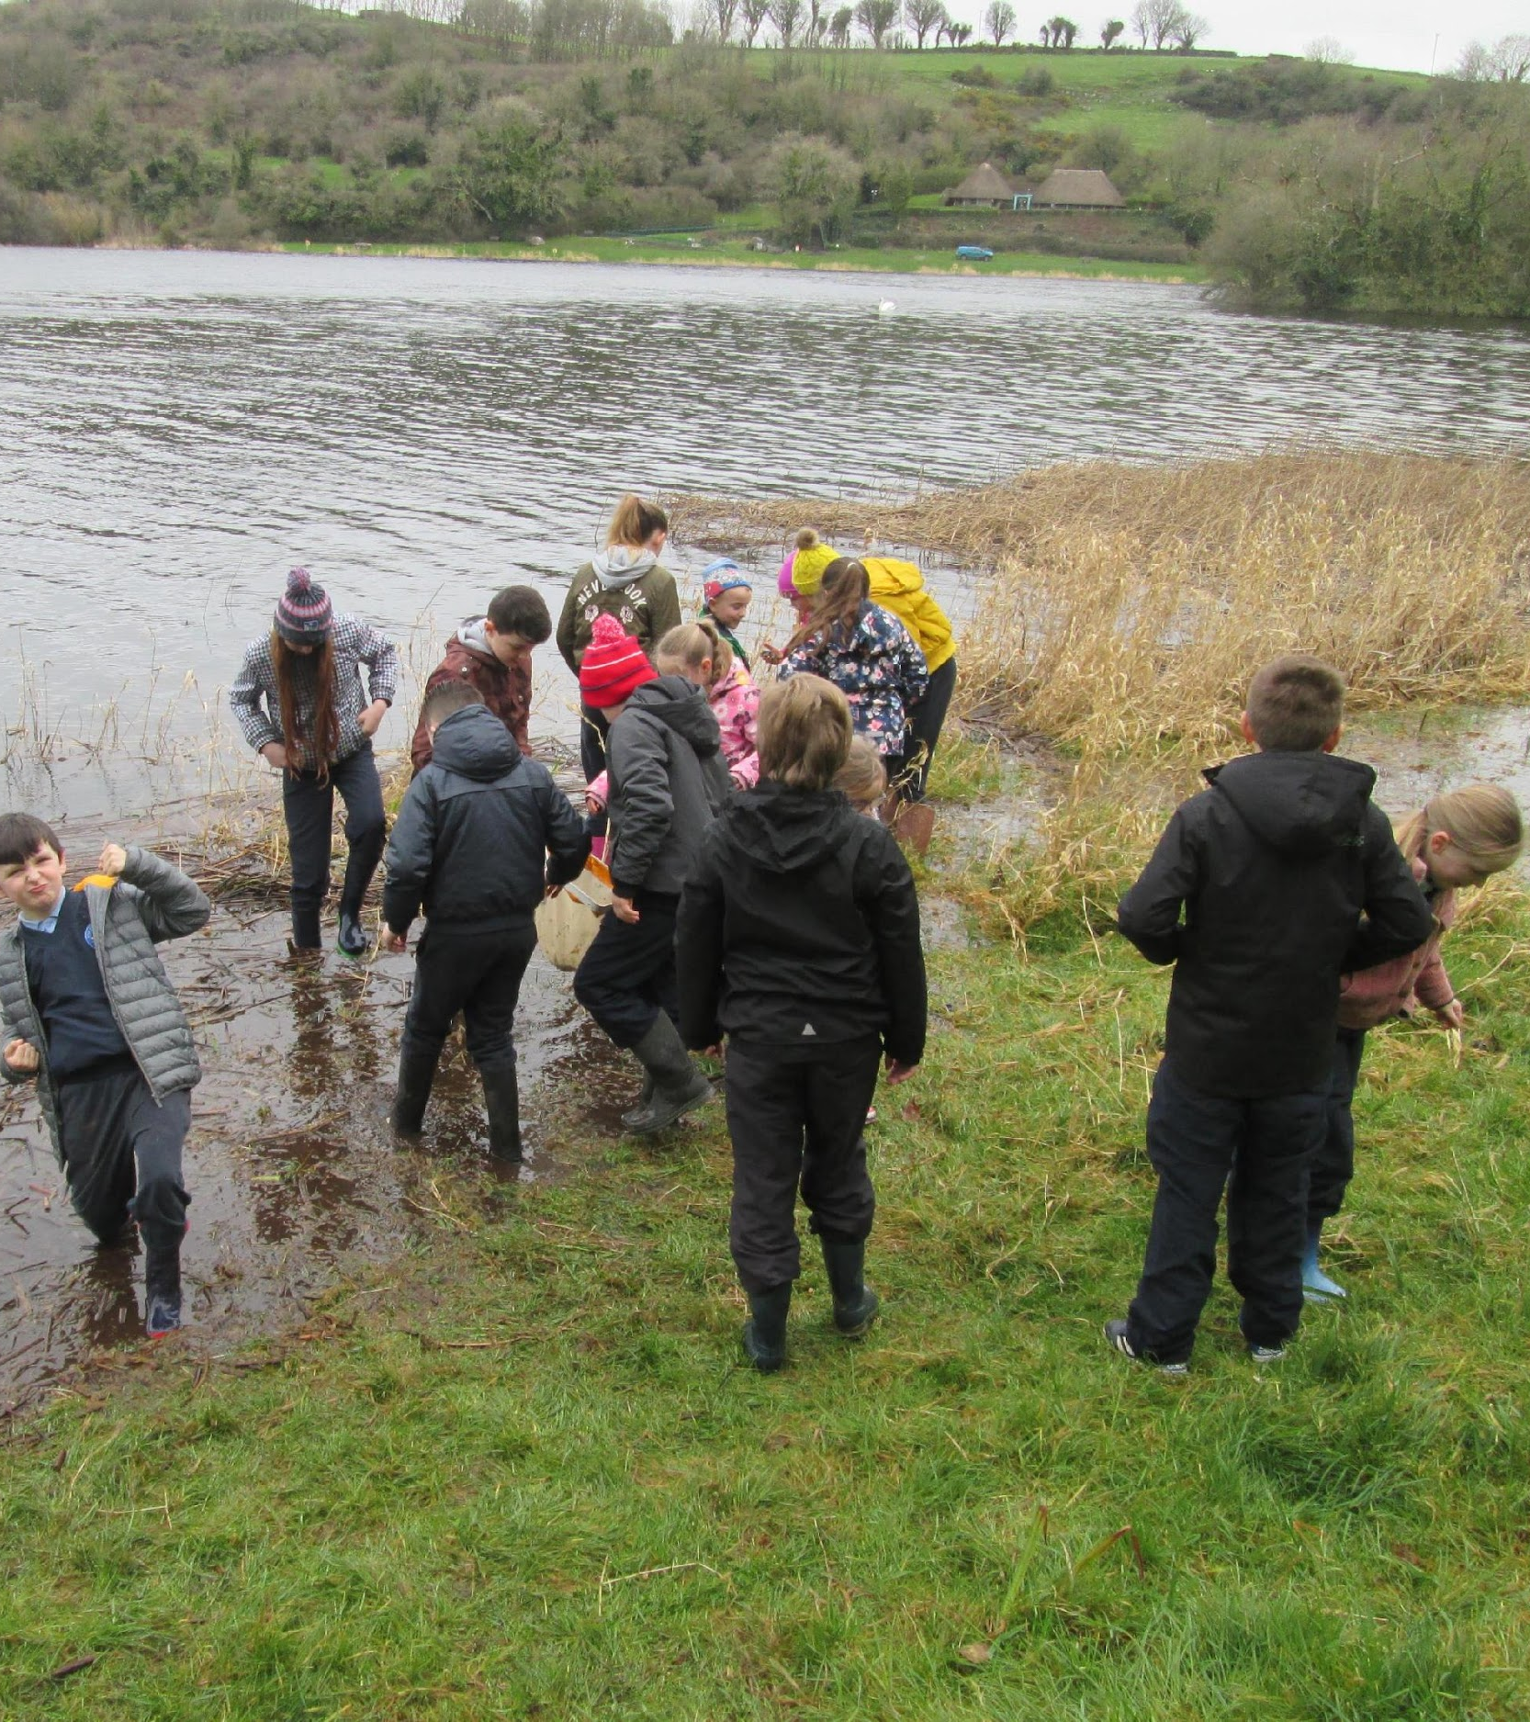
FIELD TRIPS

Slide 23
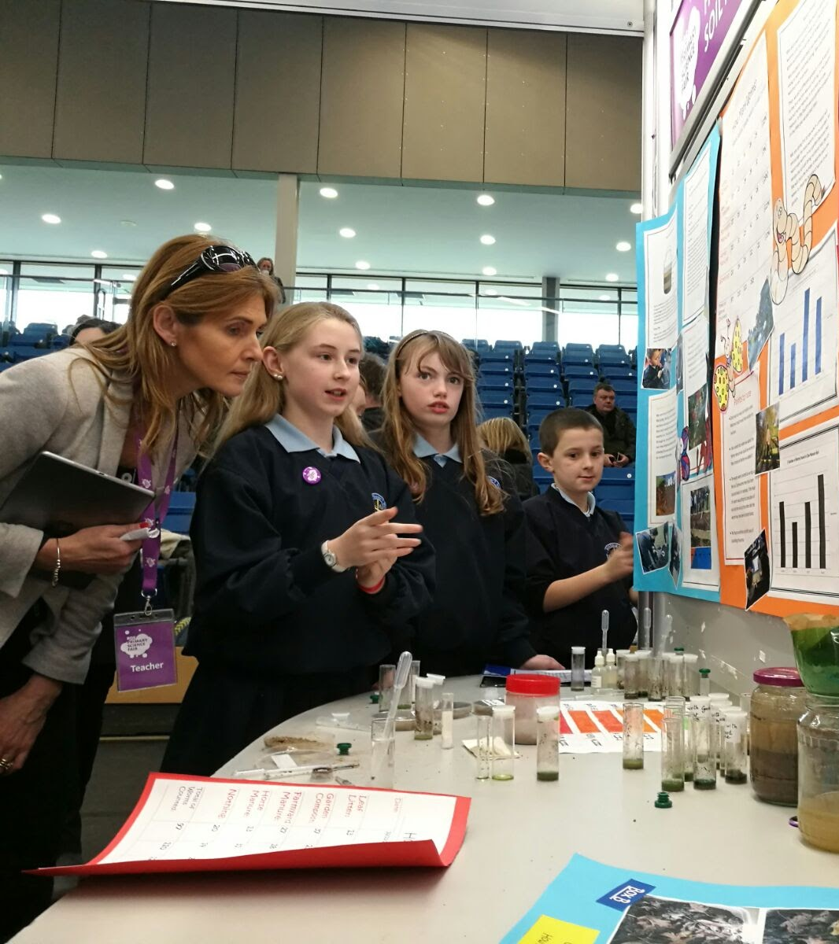
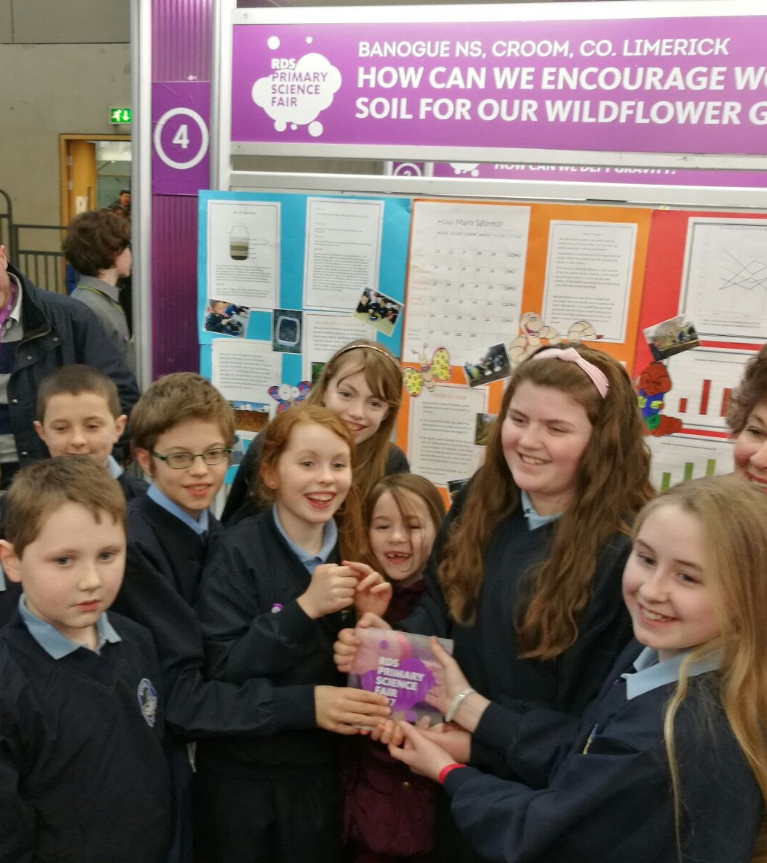
SUCCESSFUL LEARNING
Success in learning gives children a feeling of achievement, raises their confidence and self-esteem, and fosters in them an enthusiasm for further learning.

Slide 24
CURRICULUM INITIATIVES / PROGRESSIVE IN EDUCATIONAL OUTLOOK
School Self-Evaluation
Aistear: Early Childhood Curriculum Framework
Literacy lift off/Guided Readinf
Accelerated Reading Programme
Building Bridges of Understanding
Jolly Phonics / Jolly Grammar
Whole school approach to Writing Genres
STEM
Ready Set Go
Scratch coding / Robotics
Mathletics
Ógras Irish club

Slide 25
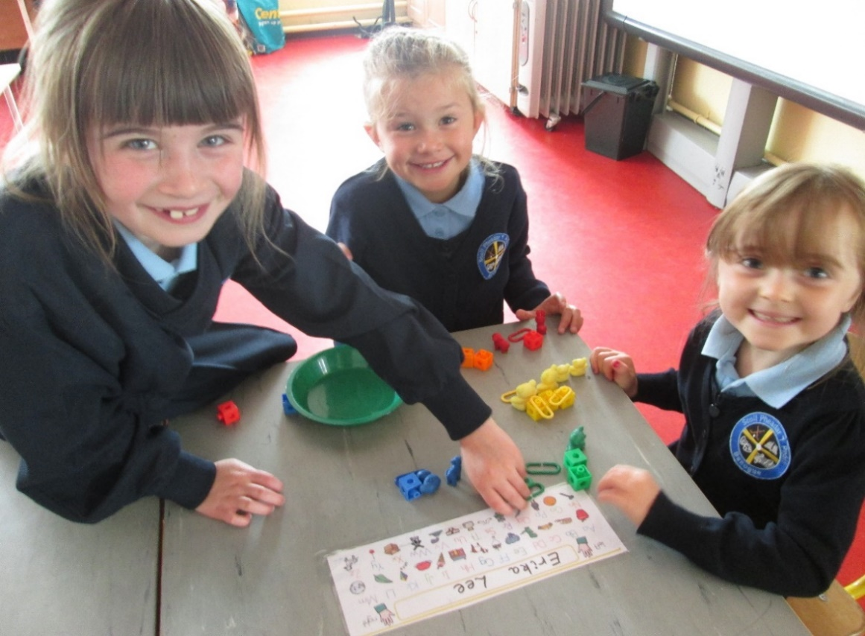
CURRICULUM INITIATIVES
Statistics prove that pupils in the school are on average, performing significantly better than the average primary school in Ireland in both Maths and English
See graph on next slide!

Slide 26
PUPILS IN BANOGUE NS PERFORM SIGNIFICANTLY BETTER IN MATHS

Slide 27
PUPILS IN BANOGUE NS PERFORM SIGNIFICANTLY BETTER IN ENGLISH

Slide 28
SOCIAL & PERSONAL HEALTH INITIATIVES
FRIENDS programme: Fun friends / Friends for life – school-based anxiety prevention and resilience building programmes
Fundamental Movement Skills Programme: Daily PE programme combines fundamental movement skills and sensory motor development – every pupil participates
Go Noodles PE Programme: Internet classroom based physical education activity programme which allows children to engage in fun physical exercise.
Arts Education / Drama / Music: is the foundation of a lot our activities in school. Arts Council Report 2016 – “Children perform better academically when exposed to Arts Education.” Creative Schools
Green Flag: This flag is given in recognition of work done in the school to promote energy saving, recycling and care for the environment

Slide 29
SPECIAL EDUCATIONAL NEEDS BANOGUE NS
2 Special Educational Needs teachers, 4 full time Special Needs Assistants
1 Special Class Teacher for pupils with Autism Spectrum Disorder . A second class has been sanctioned to open in September 2023.
Resources allocated to pupils taking into account their individual learning needs
Supports inclusion and early intervention
Pupils assessed using standardised tests to identify those that may need extra help
Regular liaison with parents , 2 parent teacher meetings yearly.
Referral to, and liaison with, professional agencies e.g. speech and language therapists, educational psychologists, occupational therapists, physiotherapists etc. when necessary

Slide 30
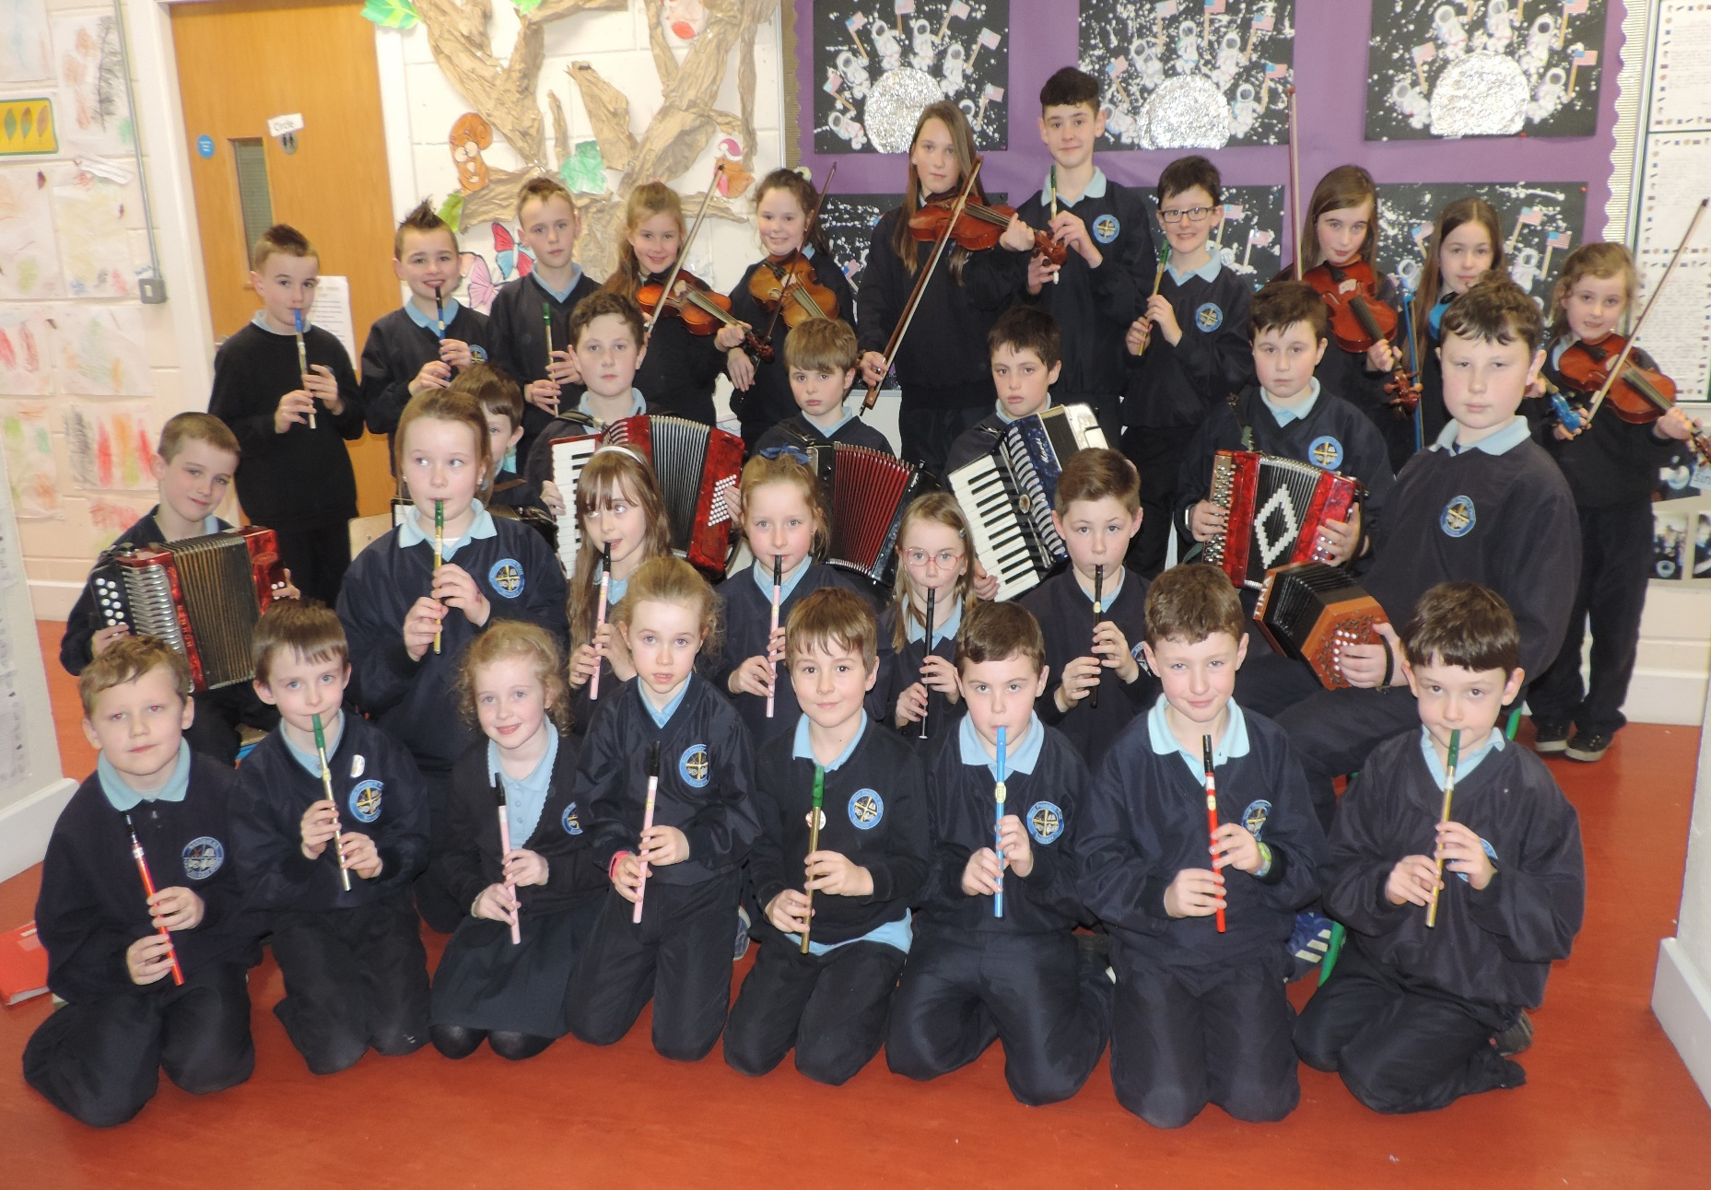
SCHOOL ACTIVITIES
Music - School Band

Slide 31
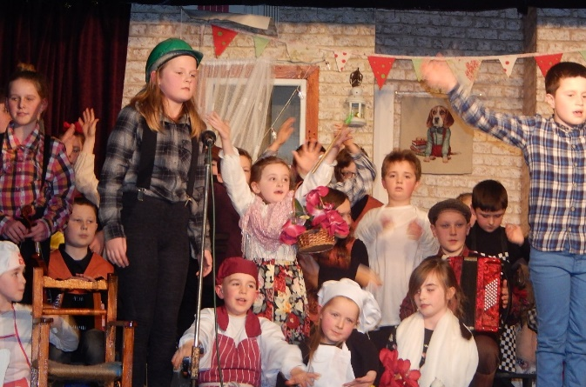
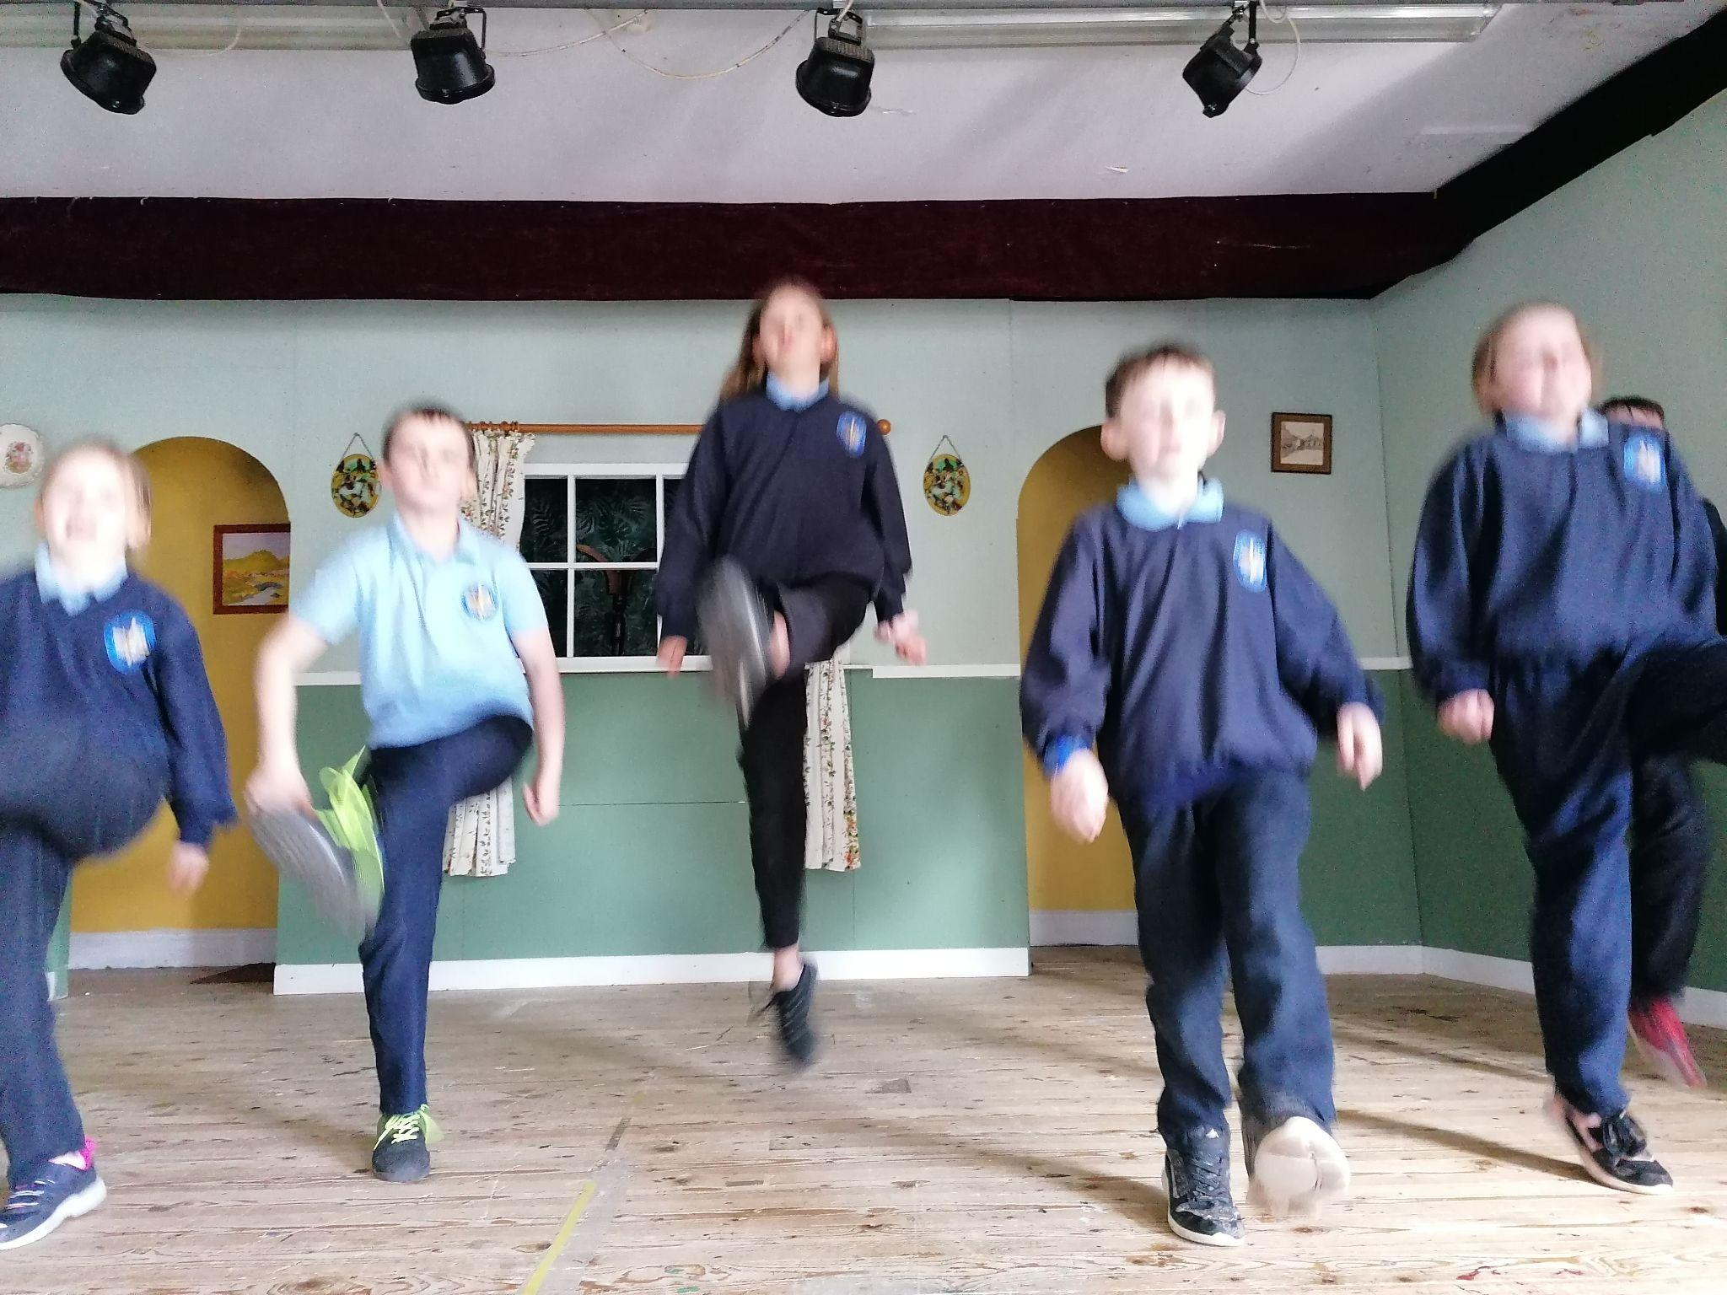
DRAMA
Our annual show includes every child in the school and gives each child an invaluable experience in stage craft, drama, music, singing and stage management.

Slide 32
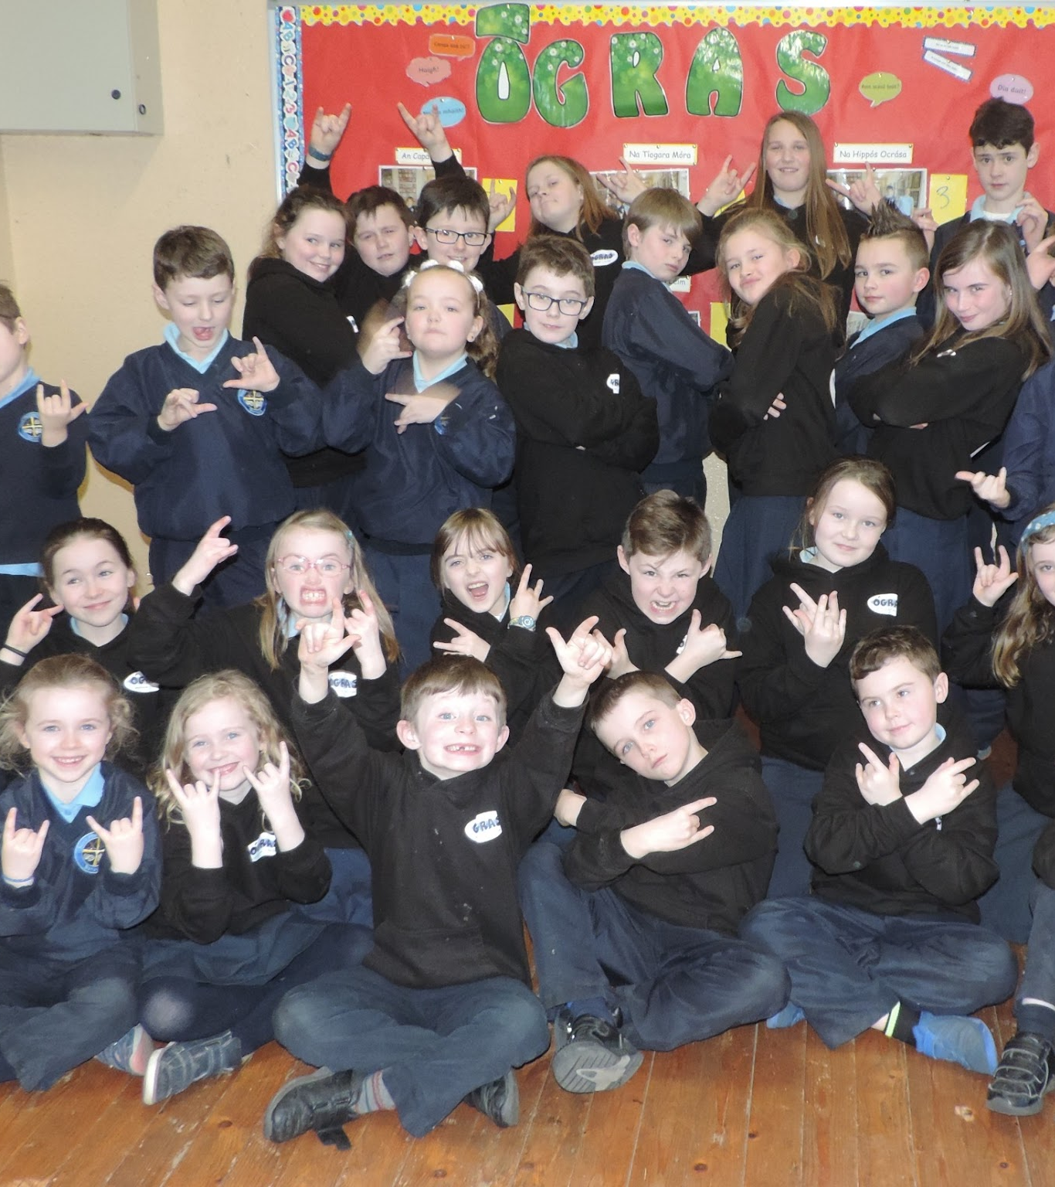
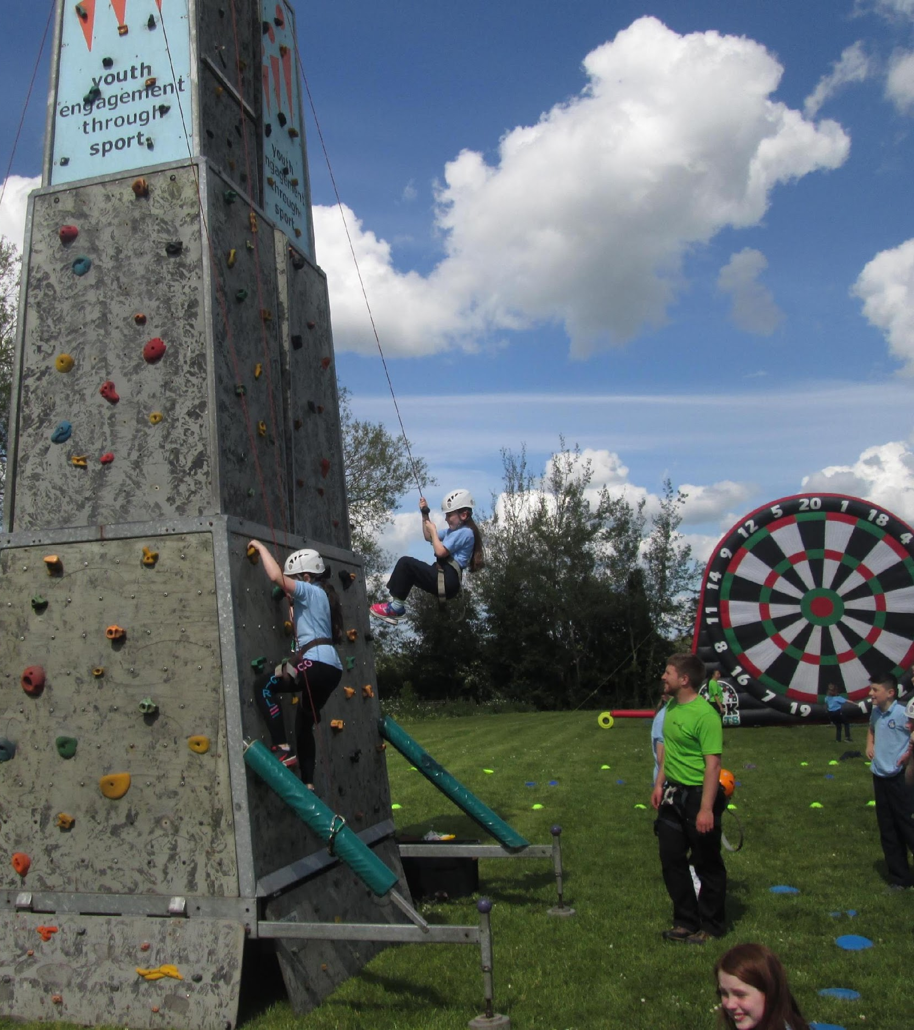
ÓGRAS IRISH CLUB
This is weekly after-school activity co-ordinated by teacher Mrs. O’ Brien
Largest Ógras club in Munster
Aim is to promote the speaking of Irish and a love of our native tongue
Activities include sports, arts & crafts, music and a club fun day

Slide 33
IRISH DANCING
WE HOPE IRISH DANCING CLASSES WILL RETURN IN SEPTEMBER 2022

Slide 34
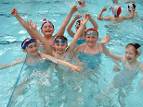
SWIMMING
Swimming lessons are available to all students from Junior Infants to sixth class each year.
These usually take place once per week over a five-week period.
Professional swimming instructors give the lessons to children

Slide 35
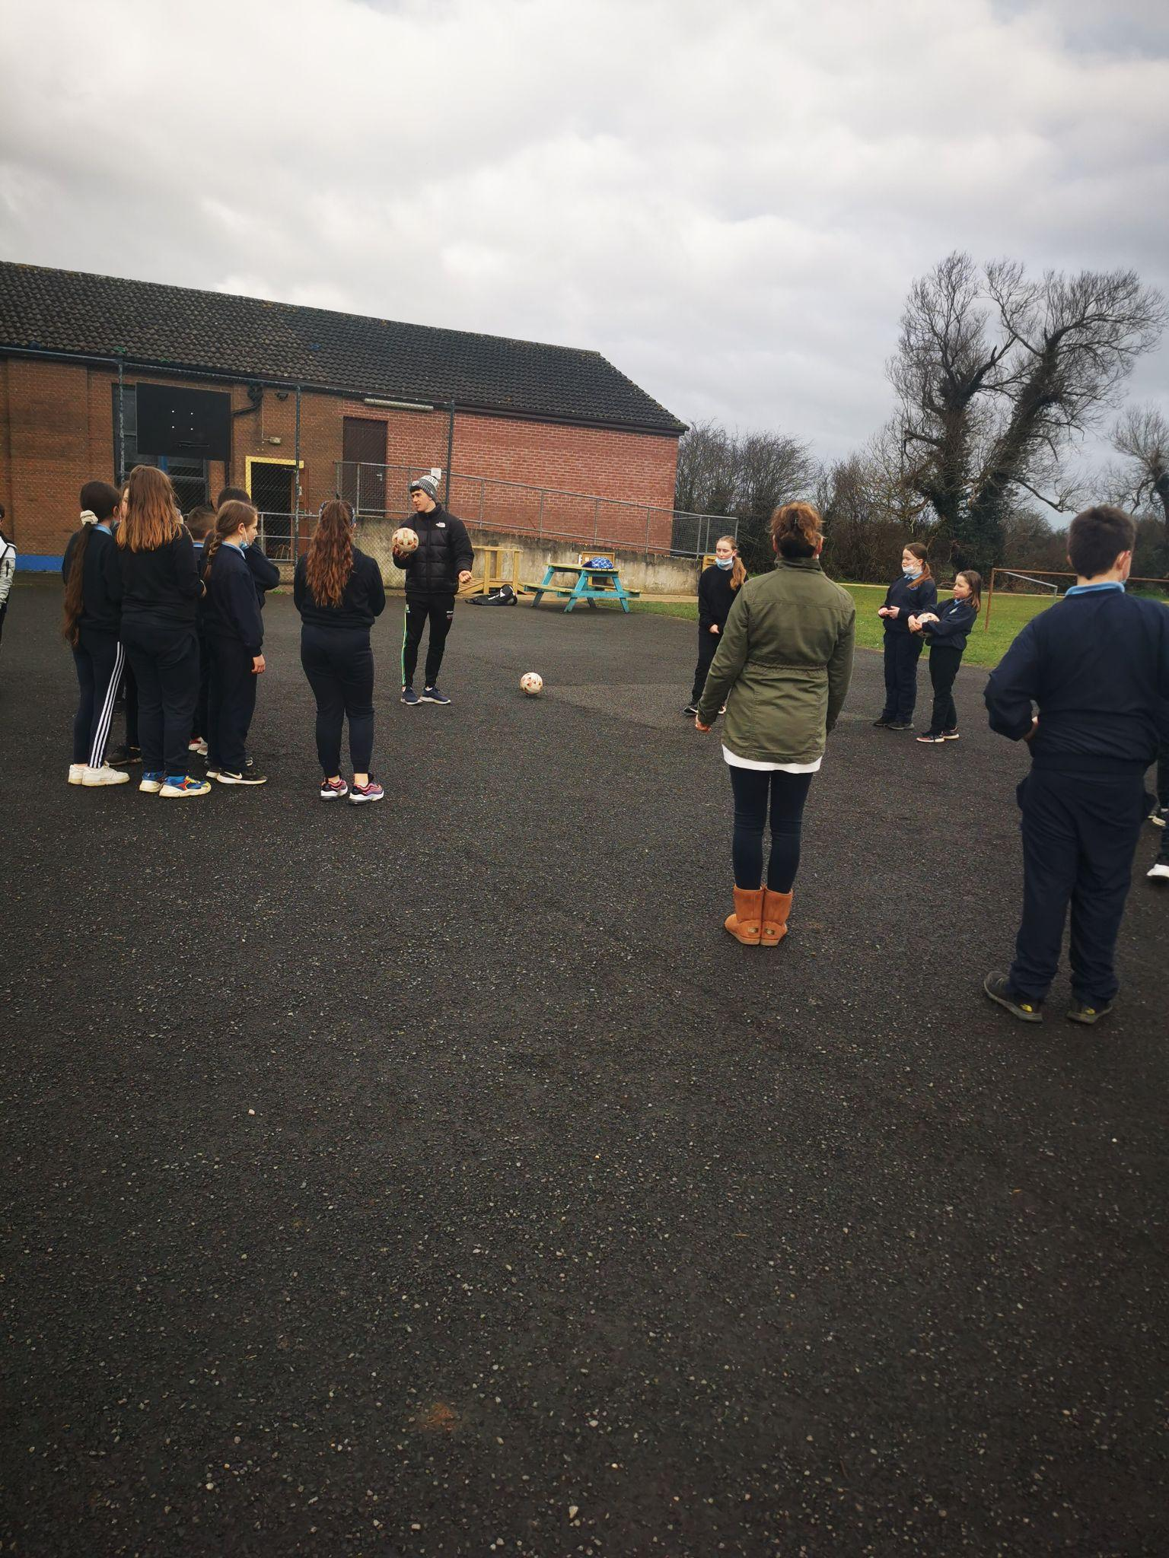
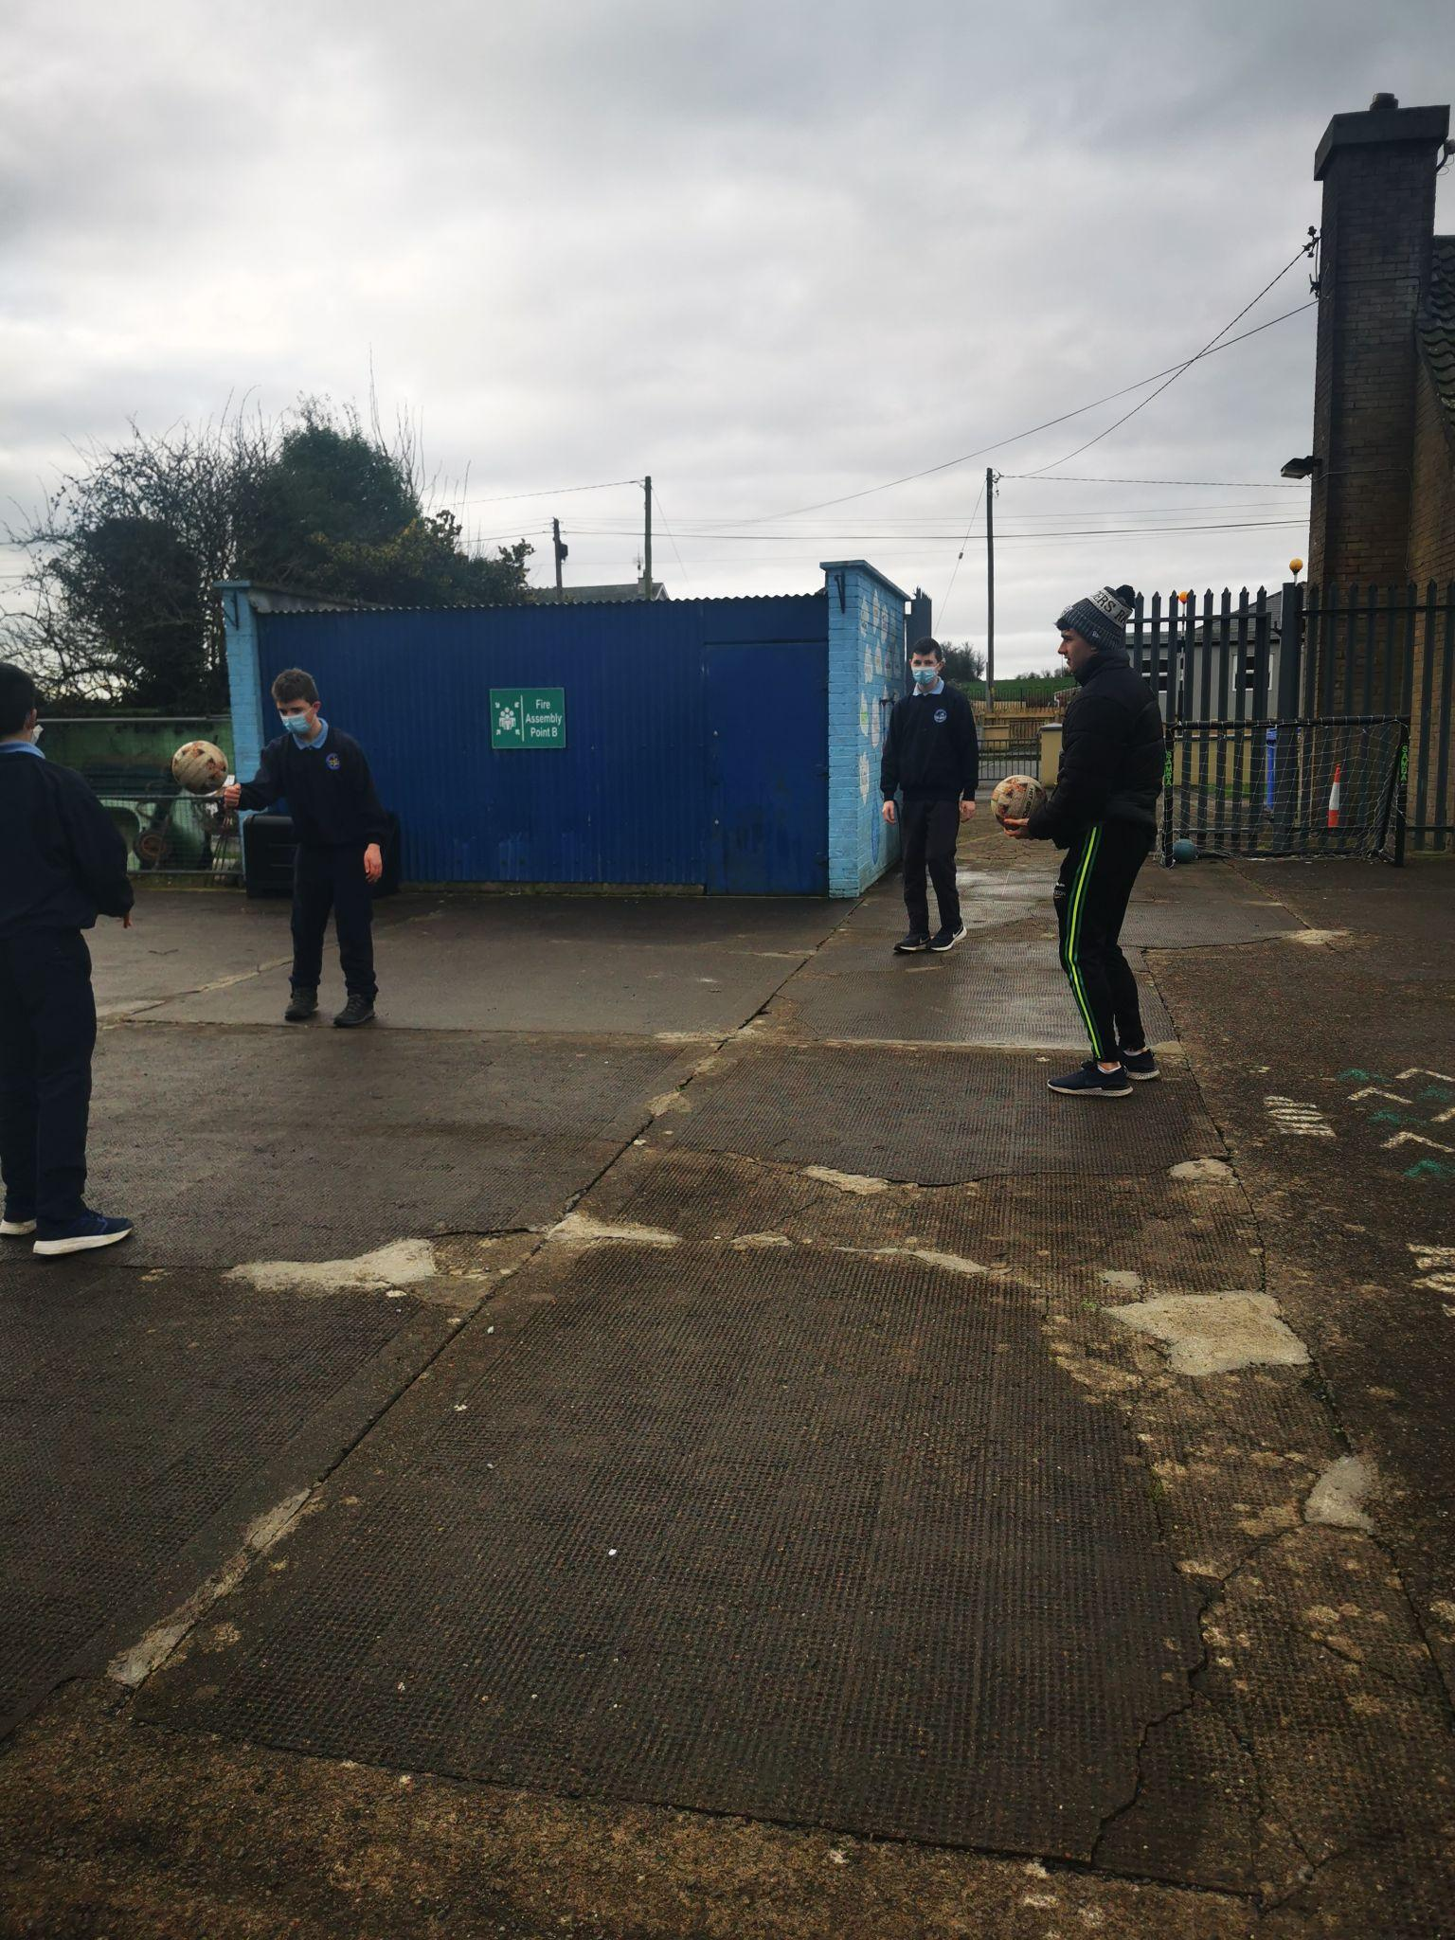
G.A.A. / SOCCER
Banogue National School has the reputation for producing highly skilled and well trained boys / girls hurling, football and camogie teams
Children have sessions with a GAA Coach every Wednesday
Our small class sizes mean that all children are given an opportunity to be part of a team.
Since it first entered the South Limerick Schools G.A.A Hurling/Football championships, it has won an impressive 18 titles.
The School enters the Football Association of Ireland’s Schools Soccer Tournament each year.

Slide 36
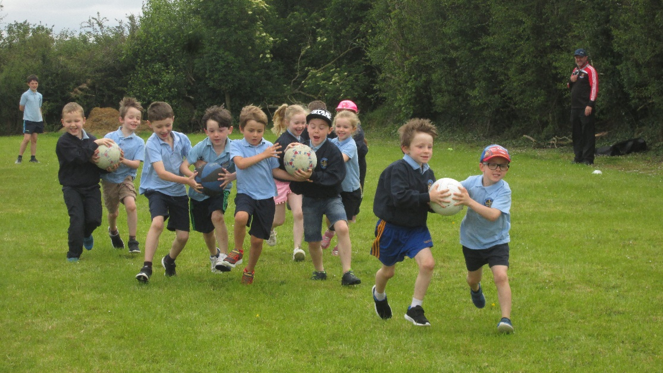
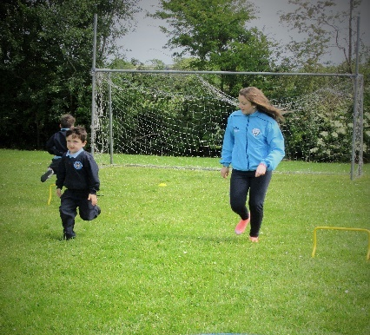
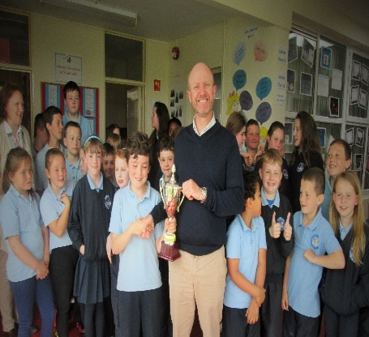
SPORTS DAY
The traditional style ‘Sports Day’ is held each year. During Sports Day, children participate in a variety of athletic and fun events including sprinting, relays and wellie throwing.
A perpetual trophy is presented each year to an individual who exhibits great team spirit whilst not necessarily being the best sportsperson.

Slide 37
COMMUNITY GAMES
Talent, handwriting, art, athletics, drama, music etc.
A local Community Games Committee working closely with the school
Children are competing at a very high standard at county and all Ireland level.
Multiple All –Ireland medalists from the school

Slide 38
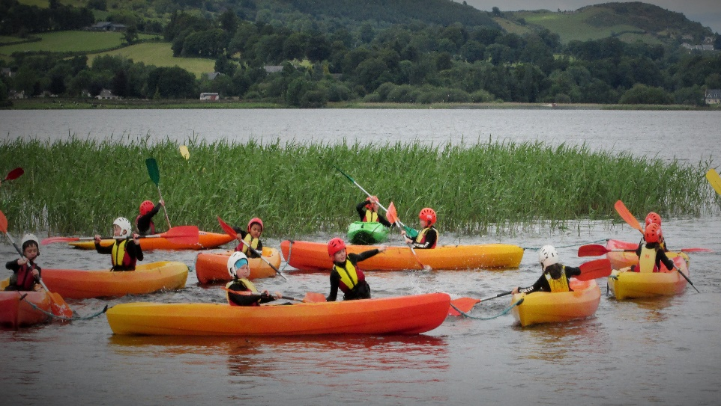
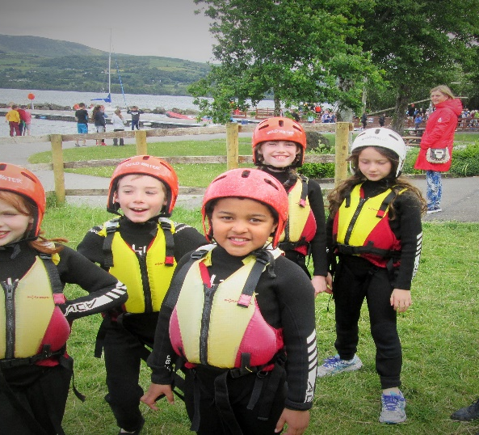
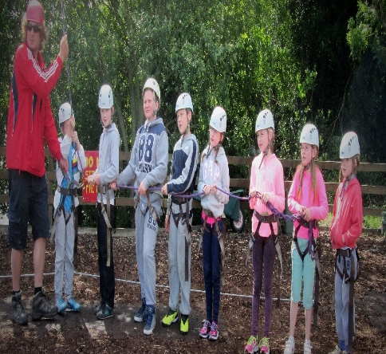
SCHOOL TOUR
This normally takes place during the summer term and usually includes visits to sights of historical, geographical, scientific or artistic interest as well as fun activities.
Many School trips to take place throughout the school year including historic, field trips etc.

Slide 39
PARENTS’ COUNCIL ACHIEVEMENTS SINCE 2015
Upgraded exterior of school including school yard, wildflower garden and sensory area - Painted school yard walls, planted flowers throughout, purchased equipment for yard, basketball hoops etc.
Funded upgrade of interior of school and hall including replacement of windows and painting of school interior classrooms, bathrooms, corridor etc.
Planned & organised very successful school events i.e. 2 fashion shows, 50th Anniversary Gala Dinner, Family fun days, Grandparents day, Team Limerick clean up among others
School Show – PC work in conjunction with staff to create props and fund sound, costumes etc.

Slide 40
TOTS TO TEENS COMMUNITY CRÈCHE

Slide 41
TOTS TO TEENS COMMUNITY CRÈCHE
Tots to Teens opened its doors in January 2008.
This service offers play based curriculums (age & appropriate) designed to stimulate all areas of development. It is located adjacent to Banogue National School. Pre-school drop off and After School collection service provided by designated crèche Staff.
Open Monday – Friday from 7.30am – 6.00pm
Service works closely with school

Slide 42
SERVICES INCLUDE:
Crèche (Children aged 3mths – 5years)
Pre-school (Children aged 3-5years)
Montessori
Before & After School service – (Children up to 12 years)
You may be eligible for cheaper rate under Government Scheme, talk to Manager for further details
"The National Childcare Scheme (NCS) commenced in November 2019 and it is available for all parents. The parents apply and are means tested and the dept will then issue a CHICK code which the service uploads to ascertain the subsidy a parent has been awarded"
Summer Camps - (Children up to 12 years)
Holiday Care - (Children up to 12 years)

Slide 43
FACILITIES AT TOTS TO TEENS
Hot Meals (HACCP Compliant)
Supervised homework.
Art & Craft Activities.
Computers.
Play rooms.
Planned activities indoor & outdoor.
Games.
Outdoor play areas (includes state of the art playground)
Sensory garden

Slide 44
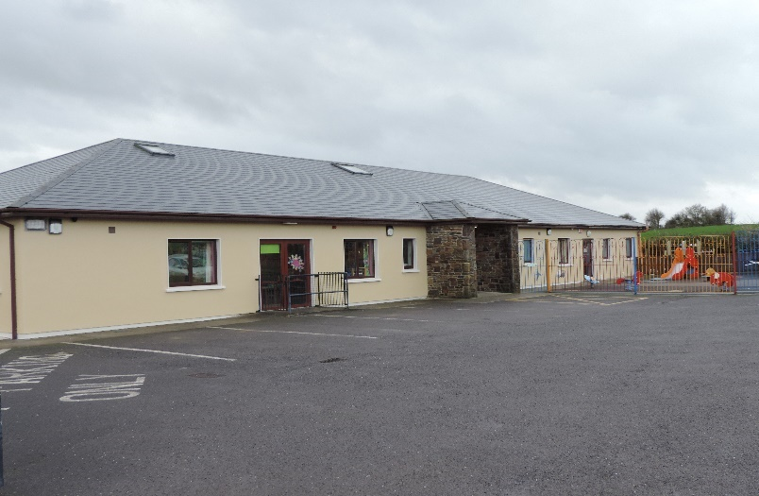
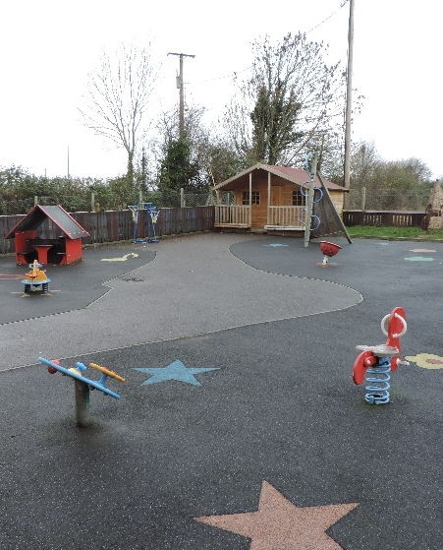

Slide 45
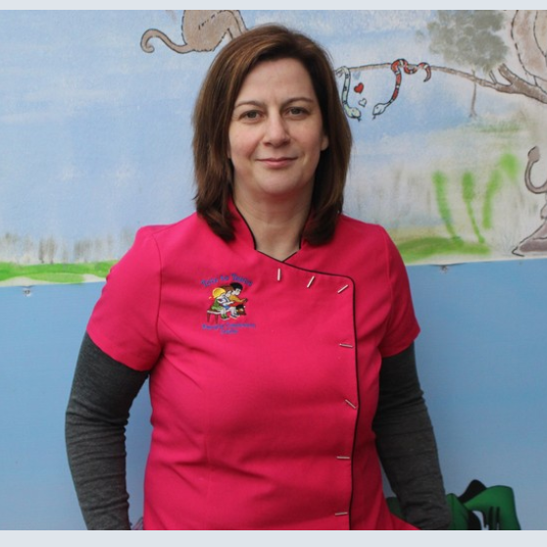
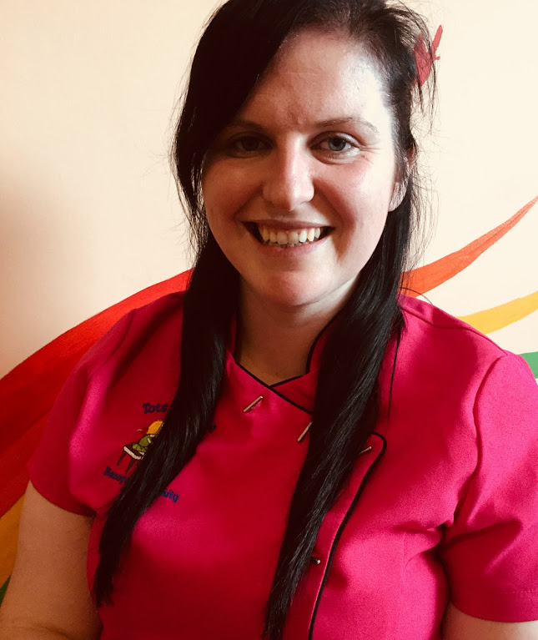
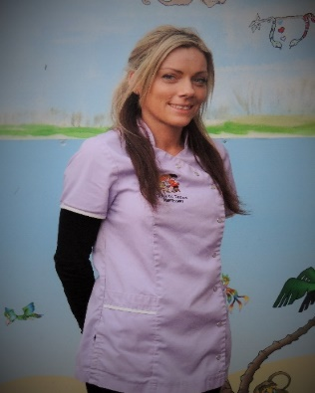
Creche Management

Slide 46
CONTACT US
If you wish to avail of any of the above services, you can contact:
Mairéad O Sullivan
Acting Crèche Manager
Tel: (061) 602818
Mob: (087) 9259582
E-mail: bcreche@gmail.com
Website: www.totstoteensbanogue.com

Slide 47
THE END

