Slide 1
2023-2024
Ms Ciara Costelloe
Banogue NS

Slide 2
Settling In Activities
June 2023- Storytelling Session: Pupils are invited into our classroom to take part in a storytelling session hosted by the infant teacher.
June 2023- Infant Welcoming Day: Pupils are invited to attend the school for a half day at the end of June. This gives them an opportunity to meet their teacher, classmates and to familiarise themselves with their new school.

Slide 3
Settling In
School starts at 9am and finishes at 1.40pm for Junior and Senior Infants.
The first few weeks in school we focus on developing relationships, establishing a routine and settling infants into school life.
Supporting your Child
Build positive relationships with school community
Get to know other parents
Listen to and talk with your child
Be involved in your child's learning e.g. reading, writing, speaking and listening

Slide 4
Junior Infants
Reading: Learning to read is gradual and much preparatory work must be done. We start with Phonological awareness. Then we move on to sounds, blending, cvc words, sentences and eventually readers.
Writing: Pre-writing skills to develop finger and hand muscles. Then moving to Formal writing
Maths: The maths programmes for infants is largely concerned with language for understanding e.g. colour, size, matching, sorting, ordering etc. Traditional sums, addition and subtraction begins later in the school year.

Slide 5
Junior Infants
Gaeilge: There is a positive attitude to Gaeilge fostered in our school. In the infant room, there is an emphasis on spoken Irish with the use of listening activities, games, conversations, vocabulary
Social skills: We encourage the use of good manners, positive interactions amongst students and teachers and the learning of appropriate behaviour.
Other areas of the curriculum which are covered are SESE, SPHE, Art Education, PE and Religion.
As part of PE, Children go to swimming lessons each year, starting in Junior Infants.

Slide 6
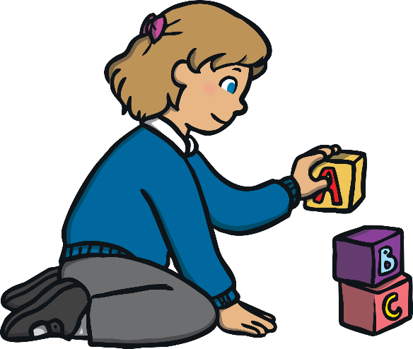
Play as part of learning in the Infant Classroom.
Play is a very important part of a child’s development.
It is how they make sense of the world around them and discover new things for themselves.
Play is encouraged and supported as it is essential to the students learning and wellbeing.
As Albert Einstein is supposed to have said, “Play is the highest form or research.”

Slide 7
Homework
Each child will have a homework folder and a homework journal. Notes to home will be put in the journal or emailed to parents.
Homework sheets will be given out each Monday for the week.
Homework should take 15-20 minutes.
Parents can contact the teacher via email at c.costelloe@banoguenationalschool.com

Slide 8
Please Remember
Label all belongings (especially jumpers and track suit tops).
Write your child’s name on the outside of all books.
The school has a healthy eating policy: chocolate, crisps, fizzy drinks or sweets are not permitted.
How to prepare your child:
Bring a re-sealable lunchbox and bottle. (Practise opening lunch things - bananas, packets, bottles etc.)
Show your child how to put on/take off their coat (buttons/zip).
Teach your child to recognise their own name.

